Slide 1
ACUTE LEUKEMİAS

Slide 2
Acute leukemia is a group of malignant (neoplastic) disorders , characterized by the clonal expansion and accumulation of one or more blood cell line(s) , with eventual involvement of all hematopoietic organs and other organs.
Notes:
The leukaemias are a heterogeneous group of malignant blood disorders.

Slide 3
Two or more Mutations within the genome of HSC or multipotential progenitors/precursors
Activation of specific proto-oncogene
De-activation of tumor suppressor genes
Prolonged life resistant to apoptosis
Growth factor independent growth
Insensitivity to growth-inhibitory signals
Ability to invade and metastasize
Blockage of intracellular differentiation Leukemia
Notes:
As for other malignancies, the evolution of leukaemia is likely to be a multistep process. Thus, accumulated genetic mutations corrupt normal cellular pathways controlling proliferation and differentiation and lead to the production of an autonomous proliferating stem cell clone (‘clonal evolution’). It is easiest to think about the aetiology in terms of these acquired genetic abnormalities and other more general predisposing factors.

Slide 4
Predisposing factors
Radiation exposure
Previous chemotherapy (particularly alkylating agents)
Occupational chemical exposure (e.g. benzene)
Some genetically determined disorders (e.g. Down syndrome)
Viral infection (only HTLV-1 proven as a causative factor)
Myelodysplastic and myeloproliferative disorders
Other possible (e.g. cigarette smoking)
Notes:
Factors predisposing to leukaemia

Slide 5
Classification
Acute leukaemia | Acute myeloid leukaemia
 | Acute lymphoblastic leukaemia
Chronic leukaemia | Chronic myeloid leukaemia
 | Chronic lymphocytic leukaemia
Other types | Hairy cell leukaemia
 | Prolymphocytic leukaemia
 | T-cell leukaemia lymphoma
Notes:
Classification of leukaemia
The leukaemias can most broadly be divided into acute and chronic types depending on their clinical course. The classification illustrated here further divides leukaemias into their cell of origin (i.e. myeloid or lymphoid) and refers to the microscopic appearance (morphology) of the leukaemic cells.
The traditional classification of the acute leukaemias is that of the FAB group – the abbreviation being for the French, American and British nationalities of the terminologists – but this has been overtaken by the World Health Organization (WHO) system. Basic morphological techniques (e.g. microscopic inspection of a blood film and bone marrow sample) remain important in the initial diagnosis but cytogenetic and molecular genetic techniques are becoming increasingly important in classification as acquired genetic changes frequently have prognostic significance and can guide treatment.

Slide 6
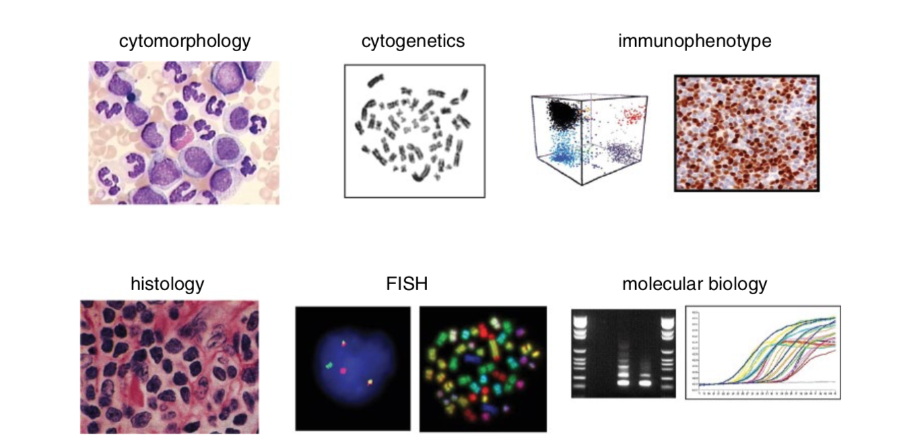
DİAGNOSIS
Notes:
Diagnostic methods used in hematology (i.e. phenotype based on cytomorphology, immunophenotyping, and histology), and genetic methods (i.e. cytogenetics, accompanied by FISH and molecular genetics). Source: Hoffbrand AV, et al. Postgraduate Haematology, 7th edn. John Wiley & Sons, 2016. Reproduced with permission of John Wiley & Sons.

Slide 7
Acute myeloid leukemia (AML) consists of a group of relatively well-defined hematopoietic neoplasms involving precursor cells committed to the myeloid line of cellular development (ie, those giving rise to granulocytic, monocytic, erythroid, or megakaryocytic elements).
AML is characterized by a clonal proliferation of myeloid precursors with a reduced capacity to differentiate into more mature cellular elements.
Notes:
As a result, there is an accumulation of leukemic blasts or immature forms in the bone marrow, peripheral blood, and occasionally in other tissues, with a variable reduction in the production of normal red blood cells, platelets, and mature granulocytes.

Slide 8
AML is the most common acute leukemia in adults and accounts for approximately 80 percent of cases in this age group .
In adults, the median age at diagnosis is approximately 65 years.
Female/Male: 5:3
Notes:
In contrast, AML accounts for less than 10 percent of acute leukemias in children less than 10 years of age.
The incidence increases with age
The male:female ratio is approximately 5:3.

Slide 9
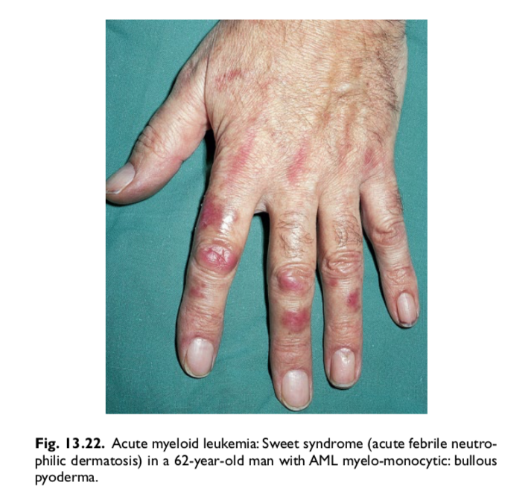
CLINICAL PRESENTATION
Pancytopenia
Infections
Hemorrhagic Findings
Fever
Skin signs
Central nervous system
Organomegaly
Myeloid sarcoma
Notes:
Patient with AML generally present with symptoms related to complications of pancytopenia including weakness and easy fatigability, infections of variable severity, and/or hemorrhagic findings such as gingival bleeding, ecchymoses, epistaxis, or menorrhagia . Combinations of these symptoms are common.
If fever is present, it is almost always related to infection
Skin — Examination of the skin can reveal pallor secondary to anemia, petechiae or ecchymoses secondary to thrombocytopenia or disseminated intravascular coagulation, or infiltrative lesions suggestive of leukemic involvement (leukemia cutis or myeloid sarcoma). Leukemic involvement of the skin occurs in up to 13 percent of patients and is most often found in patients with AML with a prominent monocytic or myelomonocytic component. The lesions are often nodular and violaceous/gray-blue in color.
Central nervous system — The incidence of central nervous system (CNS) involvement at the time of diagnosis is unknown since routine evaluation in patients without signs or symptoms is not recommended.
Organomegaly — Palpable adenopathy is uncommon in patients with AML and significant lymph node enlargement is rare. Similarly, hepatomegaly and splenomegaly are present in approximately 10 percent of cases each and, if found, may suggest the possibility of acute lymphoblastic leukemia or evolution of AML from a prior myeloproliferative disorder (eg, blast crisis of chronic myeloid leukemia)

Slide 10
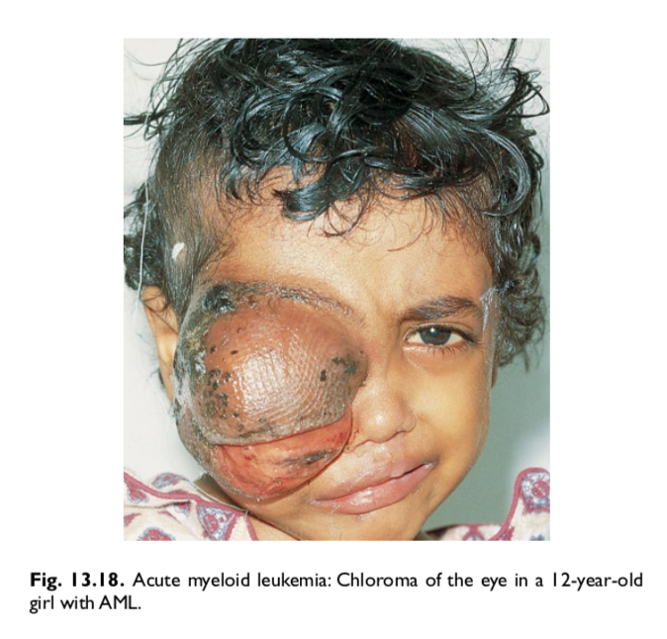
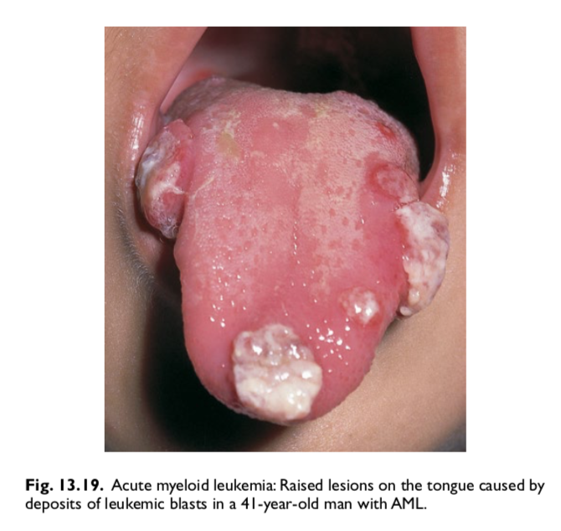
Myeloid sarcoma
Less than 1 percent of patients will present with prominent extramedullary disease (ie, myeloid sarcoma, also called granulocytic sarcoma, myeloblastoma, or chloroma)
Sites of isolated myeloid sarcoma include bone, periosteum, soft tissues, and lymph nodes, and less commonly the orbit, intestine, mediastinum, epidural region, uterus, and ovary

Slide 11
Peripheral blood
Normocytic, normochromic anemia
Reticulocyte count N or
Thrombocytopenia
The median leukocyte count at diagnosis is approximately 15,000 cells/microL; 20 percent of patients have a leukocyte count above 100,000 cells/microL and 25 to 40 percent of patients have a leukocyte count less than 5000 cells/microL. The vast majority of patients (95 percent) will have circulating myeloblasts that can be detected on the peripheral smear.
Notes:
Analysis of the peripheral blood at presentation usually reveals a normocytic, normochromic anemia that can vary in severity. The reticulocyte count is normal or decreased. Approximately 75 percent of patients have platelet counts below 100,000 cells/microL (100 x 10⁹/L) at diagnosis, and approximately 25 percent will have counts below 25,000 cells/microL. Both morphologic and functional platelet abnormalities may be seen.

Slide 12
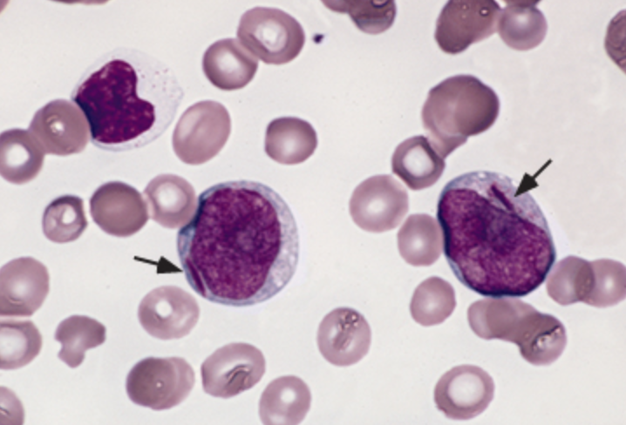
Myeloblasts are immature cells with large nuclei, usually with prominent nucleoli, and a variable amount of pale blue cytoplasm (sometimes with faint granulation) after staining with Wright Giemsa.
The nuclear to cytoplasmic ratio and morphology vary depending upon the maturity of the cell.
Auer rods, which are pathognomonic of myeloblasts, vary in frequency depending upon the AML subtype.
They can be identified as pink/red rod-like granular structures in the cytoplasm.
Sometimes the Auer rods are multiple, and sometimes they form a dense clump and are referred to as "Auer bodies."
Notes:
Peripheral smear from a patient with acute myeloid leukemia. There are two myeloblasts, which are large cells with high nuclear-to-cytoplasmic ratio and nucleoli. Each myeloblast has a pink/red rod-like structure (Auer rod) in the cytoplasm (arrows).

Slide 13
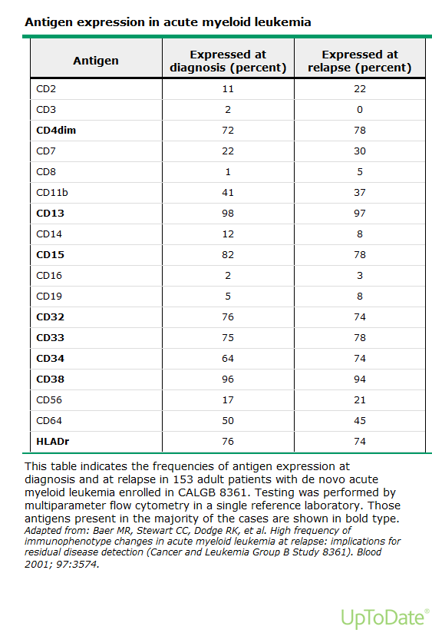
Flow cytometry
Flow cytometry of the peripheral blood or marrow aspirate can identify circulating myeloblasts in the majority of patients by characteristic patterns of surface antigen expression.
The specific pattern differs among the AML subtypes, but the majority of cases express CD34, HLA-DR, CD117, CD13, and CD33.
Myeloblasts may express T or B cell antigens, most commonly in cytogenetically defined subtypes of AML (eg, CD19 expression in AML with RUNX1-RUNX1T1, CD2 expression in acute promyelocytic leukemia [APL]) and in acute leukemias of ambiguous lineage (mixed phenotype acute leukemia [MPAL]).

Slide 14
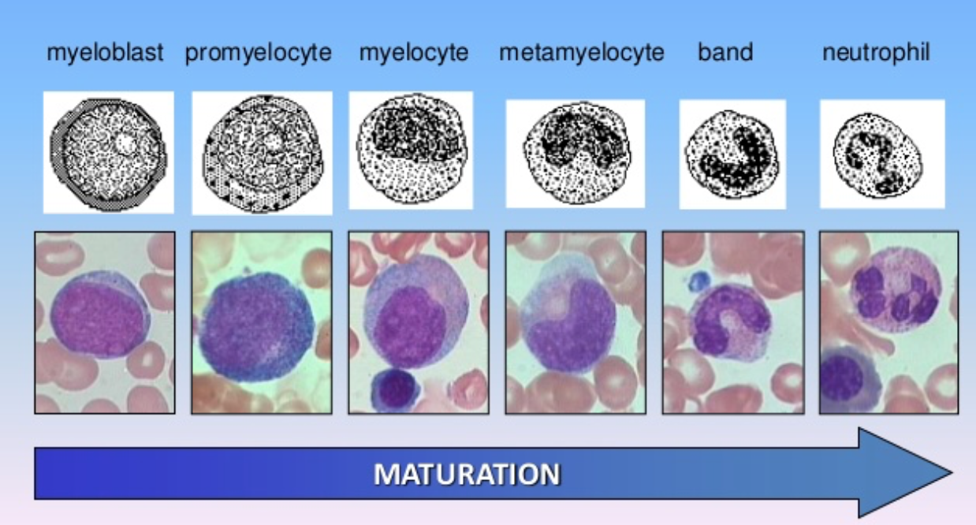
Bone marrow biopsy and aspirate
The bone marrow biopsy gives a general overview of the degree of involvement and specific histologic features associated with the process (eg, fibrosis, necrosis).
The aspirate provides material for a 500-cell differential count to determine the percentage of blasts in the marrow; it also provides for detailed cytologic evaluation of the blasts and other cells that may be residual normal hematopoietic elements or abnormal cells maturing from the blasts.
Notes:
Bone marrow aspiration and biopsy (usually unilateral) is a key component to the diagnosis of AML.

Slide 15
Cell origin
●The presence of an Auer rod on microscopy .
●Cytochemical studies demonstrating positivity for Sudan black B, myeloperoxidase, chloroacetate esterase, or nonspecific esterase.
●Flow cytometry identifying the expression of myeloid antigens.
●Specific cytogenetic abnormalities that are seen only in myeloid leukemias.
●Next-generation sequencing (NGS) on a panel of genes that are commonly mutated in AML ("myeloid gene panel")
The blasts in AML must be identified as cells of the myeloid, monocytic, erythroid, or megakaryocytic lineage and are distinguished from blasts of the lymphoid lineage seen in acute lymphoblastic leukemia.
Notes:
The non-lymphoid lineage of the AML blasts can be identified by any of the following:

Slide 16
In the current World Health Organization classification system, blast forms must account for at least 20 percent of the total cellularity.
The presence of these genetic abnormalities are considered diagnostic of AML without regard to the blast count:
●AML with t(8;21)(q22;q22); RUNX1-RUNX1T1 (previously AML1-ETO)
●AML with inv(16)(p13.1q22) or t(16;16)(p13.1;q22); CBFB-MYH11
●APL with t(15;17)(q24.1;q21.1); PML-RARA
The presence of a myeloid sarcoma is also diagnostic of AML, independent of the blast count.
Notes:
In addition,

Slide 17
Cytogenetic features
All patients with suspected AML should undergo metaphase cytogenetic analysis of their bone marrow biopsy specimen.
A combination of conventional karyotypic analysis plus reverse transcriptase polymerase chain reaction (RT-PCR) or fluorescent in situ hybridization (FISH) for specific abnormalities can aid in the diagnosis, treatment, and post-treatment monitoring of patients with AML.
Notes:
Approximately 50 percent of patients with newly diagnosed AML will demonstrate cytogenetic abnormalities.

Slide 18
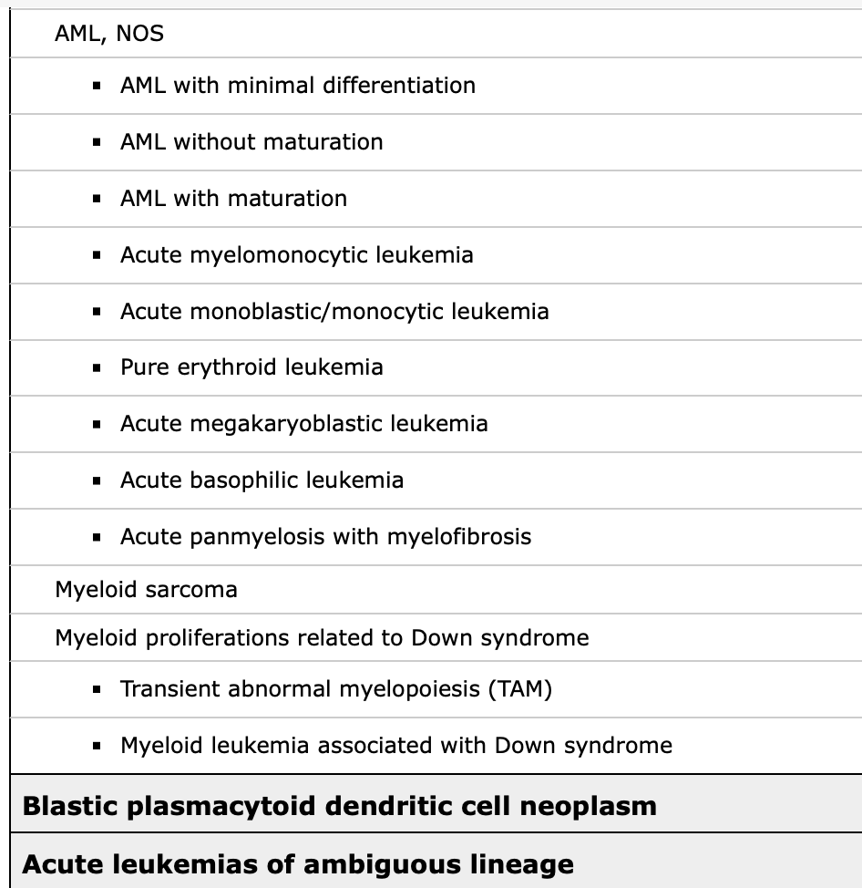
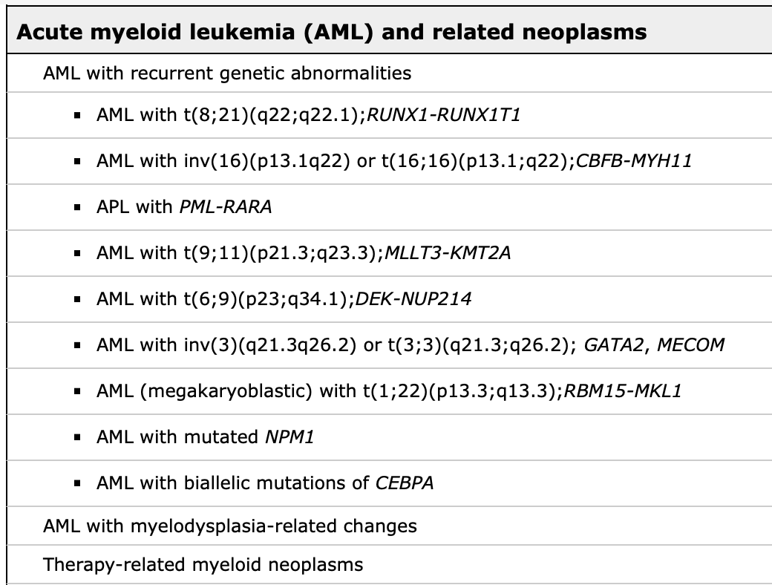
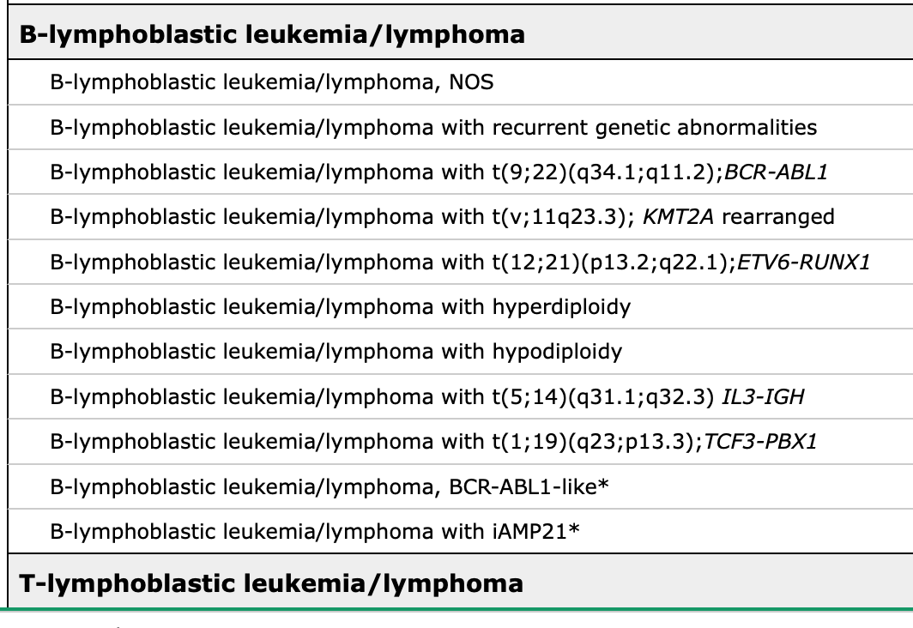
Notes:
There are six main groups of AML recognized in this classification system

Slide 19
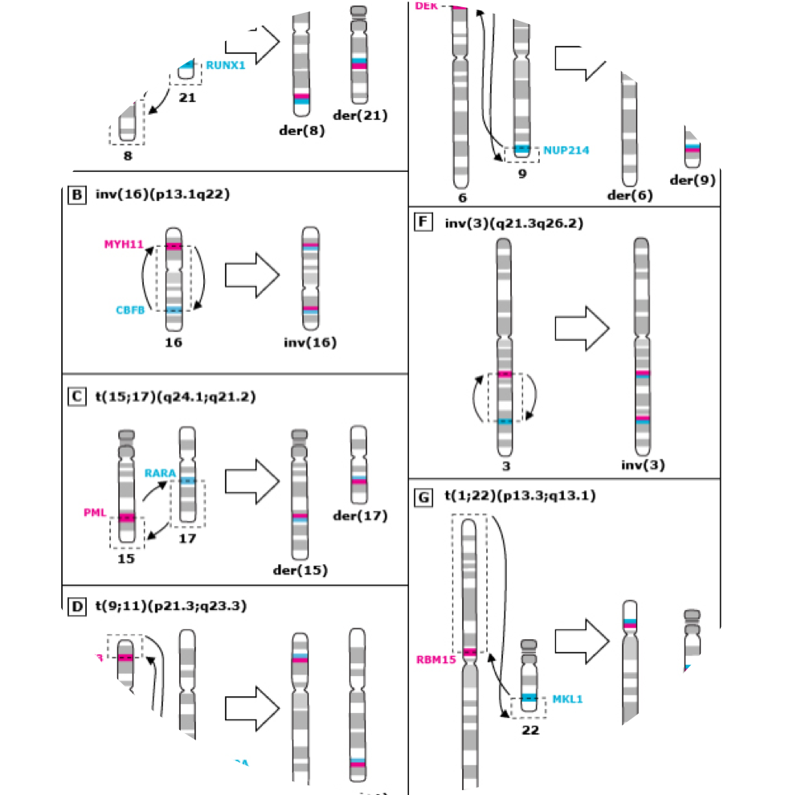
Acute promyelocytic leukemia (APML) M3
• Younger adults
• Fusion of a truncated retinoic acid receptor alpha (RAR-alpha) gene on chromosome 17 to a transcription unit called PML (for promyelocytic leukemia) on chromosome 15 t(15;17)
• The blasts are large with abundant cytoplasm, completely occupied by closely packed large granules, staining bright pink, red or purple
• The nucleus is often bilobed or markedly indented with a prominent nucleolus
• Cells containing bundles of Auer rods "faggots" randomly distributed in the cytoplasm are characteristic, but are not present in all cases

Slide 20
APL is often associated with clinical or laboratory evidence of disseminated intravascular coagulation (DIC) and fibrinolysis, which may worsen during the initial cytolytic response to chemotherapy.
A characteristic folded, reniform (kidney-shaped), or bilobed nucleus is usually found in some of the promyelocytes; coarse azurophilic granules and multiple Auer rods are also common
APL represents a medical emergency with a high rate of early mortality, but, if managed appropriately, usually has a very favorable outcome.

Slide 21
Pretreatment evaluation
History and physical examination
Renal insufficiency,
Liver disease,
Dental conditions,
Drug allergies.
Assessment should include determination of the level of physical functioning (eg, performance status measures of comorbidity) and cognitive function, especially in elderly or frail individuals.
Laboratory studies should include complete blood count (CBC) with differential, coagulation studies, serum chemistries, and viral serologies.
Bone marrow examination should include morphology, flow cytometry, karyotype, and molecular analysis to diagnose and classify AML.
A chest X-ray, electrocardiogram, and echocardiogram or MUGA scan to assess ejection fraction should be performed at baseline.
Most patients will require a central venous access catheter.
Human leukocyte antigen (HLA) typing should be considered for patients who are potential candidates for hematopoietic cell transplantation.
Notes:
Pretreatment evaluation for AML should include a thorough
and comorbid conditions Particular attention should be paid to the presence of

Slide 22
AML Treatment:
Induction Chemotherapy
 Anthracycline (Idarubicin) for 3 days and Cytosine arabinoside (Ara-C) for 7 days (3+7, Younger/fit patients only)
 Supportive care red cell and platelet transfusions, prophylactic antibacterial, antifungals and antivirals

Slide 24
Consolidation Following induction into Complete Remission 3-4 cycles of high dose cytosine arabinoside (HiDAC) administered approximately every 5-6 weeks
 Bone marrow (peripheral blood stem cell) transplant (Depends on degree of risk)

Slide 25
Treatment of AML-M3 or APL
 Treatment differs from all other AML subtypes once had the worst prognosis now the best prognosis
 Treated with a derivative of Vitamin A (all trans retinoic acid or ATRA)
 Favorable prognosis if diagnosed just prior to starting chemotherapy (>80% cured)
 Has chromosomal translocation, t(15;17) involving the retinoic acid receptor-a gene that blocks normal granulocyte differentiation
Notes:
 Blasts and promyelocytes heavily granulated, Auer rods often abundant
 Disseminated intravascular coagulation (DIC) common

Slide 26
Acute Lymphoid Leukemia
Malignant neoplastic proliferation and accumulation of immature and nonfunctional Lymphoid line of blood cells in the bone marrow.
Acute lymphocytic leukemia is the most common type of cancer in children .

Slide 28
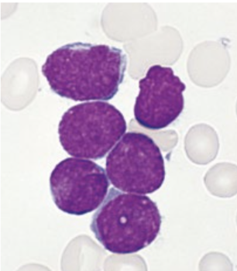
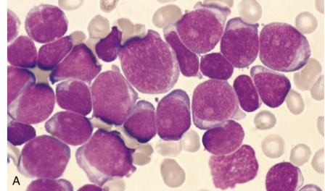
Large blasts (1.5–3 times the size of RBC)
Blasts with large, irregular nuclei (high nuclear-to- cytoplasm ratio)
Inconspicuous nucleoli
Coarse granules
No Auer rods
LENFOBLAST
Large blasts (2–4 times the size of RBC)
Blasts with round or kidney-shaped nuclei, comparatively more cytoplasm than in ALL
Prominent nucleoli
Fine granules
Auer rods (present in 50% of cases)
MYELOBLAST

Slide 29
Acute leukemia is a malignant neoplastic disease that arises from either the lymphoid cell line (acute lymphoblastic/lymphocytic/lymphoid leukemia, or ALL) or the myeloid cell line (acute myeloid/myelogenous/myelocytic leukemia, or AML).
ALL is the most common childhood malignancy, whereas AML primarily affects adults.
An underlying cause is rarely identifiable, but risk factors include prior chemotherapy and radiation therapy, as well as hereditary syndromes such as Down syndrome. AML is also associated with pre-existing hematologic disorders (e.g., myelodysplastic disorder, myeloproliferative disorders).
Acute leukemias are characterized by the proliferation in the bone marrow of immature, nonfunctional white blood cells (“blasts”) that impair normal hematopoiesis and lead to pancytopenia manifesting with symptoms and signs of anemia (↓ RBCs), clotting disorders (↓ thrombocytes), and increased susceptibility to infection (↓ fully functional, mature WBCs).
Leukemic cells also infiltrate extramedullary organs, resulting in hepatosplenomegaly and, less commonly, involvement of the skin, CNS, and/or scrotum.
S
U
M
MA
R
Y

Slide 30
Patients with AML, in particular, may develop extremely high WBC counts, increasing the risk of leukostasis and DIC.
The first diagnostic steps include a complete blood count and peripheral blood smear to determine the WBC count and the presence of blasts.
Bone marrow biopsy or aspiration with subsequent cytogenetic analysis and immunophenotyping confirm the diagnosis.
A chemotherapy regimen consisting of high-dose (induction) and low-dose (consolidation and maintenance) cycles is the mainstay of treatment.
Additional measures, such as allogeneic stem cell transplantation, may be indicated in patients with poor prognostic factors (e.g., unfavorable cytogenetics) or if initial chemotherapy fails.
S
U
M
MA
R
Y

