Slide 1

HEMATOPOİETİC
STEM CELL TRANSPLANTATİON
ENGİN KELKİTLİ MD

Slide 2
The human leucocyte antigen system (HLA)
The human leucocyte antigen (HLA) genes are located within the major histocompatibility complex (MHC) on the short arm of chromosome 6 (6p21.3)
HLA genes found in the class I region of the MHC differ in structure from those found in the class II region.
The three classical class I proteins, HLA-A, HLA-B and HLA-C are expressed on virtually all nucleated cells and also on platelets.
Notes:
Immunological basis of stem cell transplantation

Slide 3
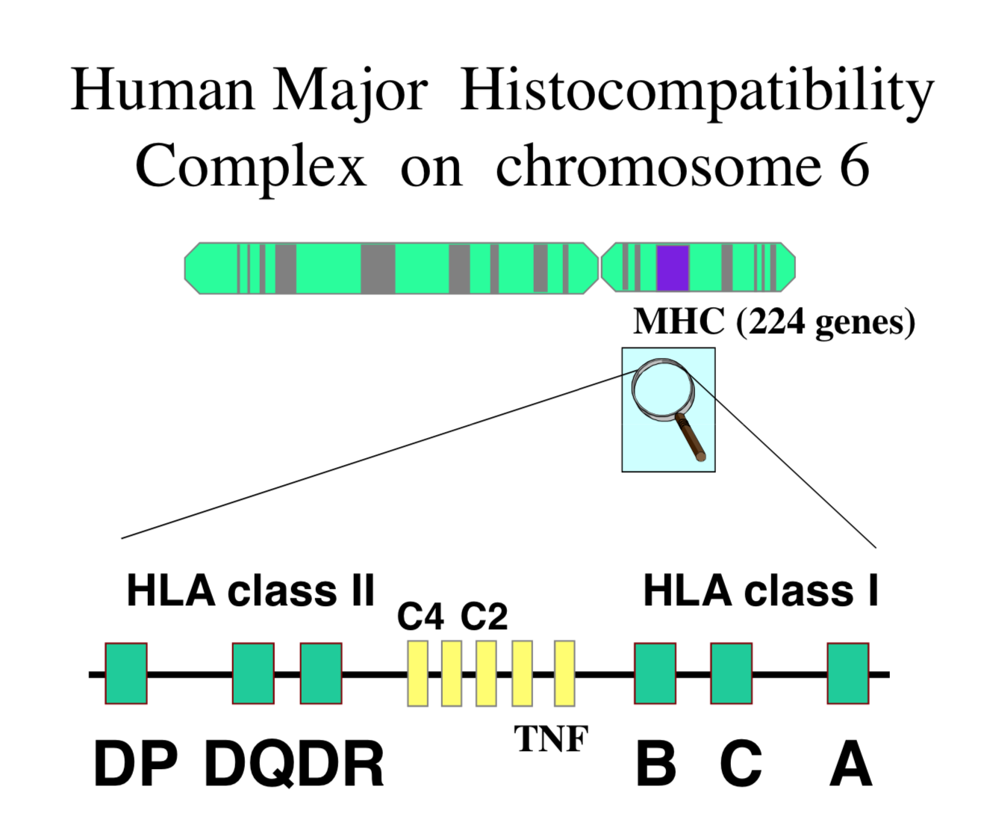

Slide 4
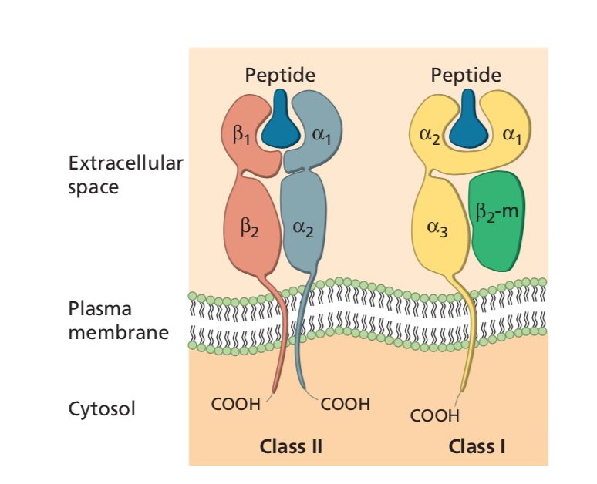
Notes:
Diagrammatic representation of HLA class I and II molecules showing protein domains and bound peptide.

Slide 5
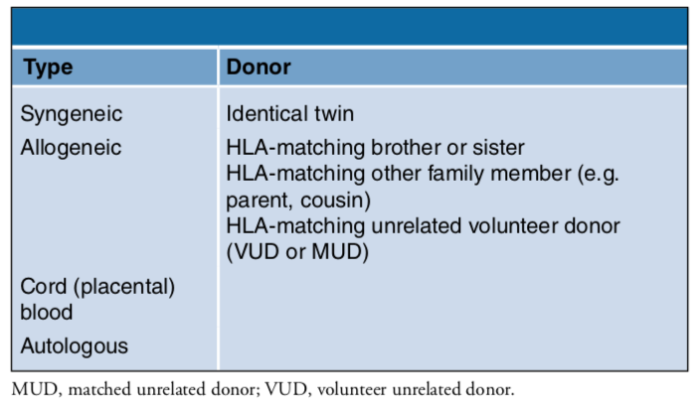
Notes:
The selection of a donor is a critical element contributing to the success of hematopoietic cell transplantation (HCT). There are several possible donor options:
●An identical twin (syngeneic, HLA identical)
●A sibling, relative, or unrelated donor (allogeneic, which can be HLA identical, haploidentical, or mismatched)
●Umbilical cord blood (allogeneic, which can be HLA identical, haploidentical, or mismatched)
●The patient (autologous, HLA identical)

Slide 6
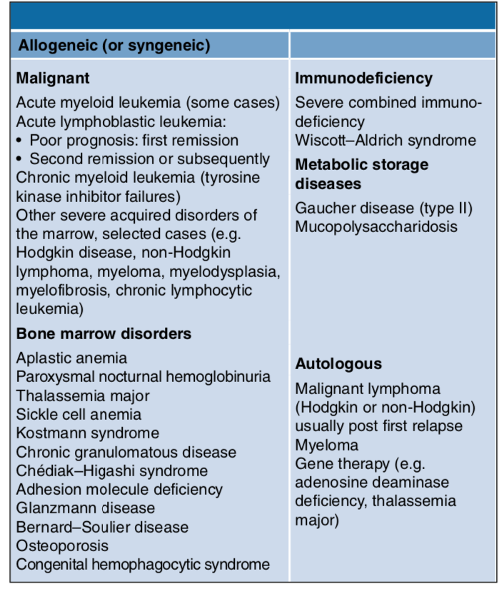

Slide 7
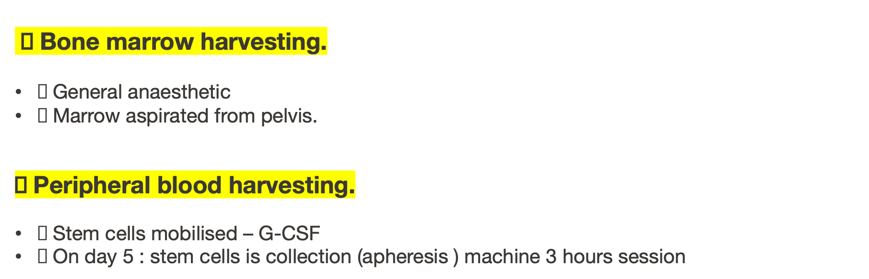
Transplant process:
1-Stem cells collection

Slide 8
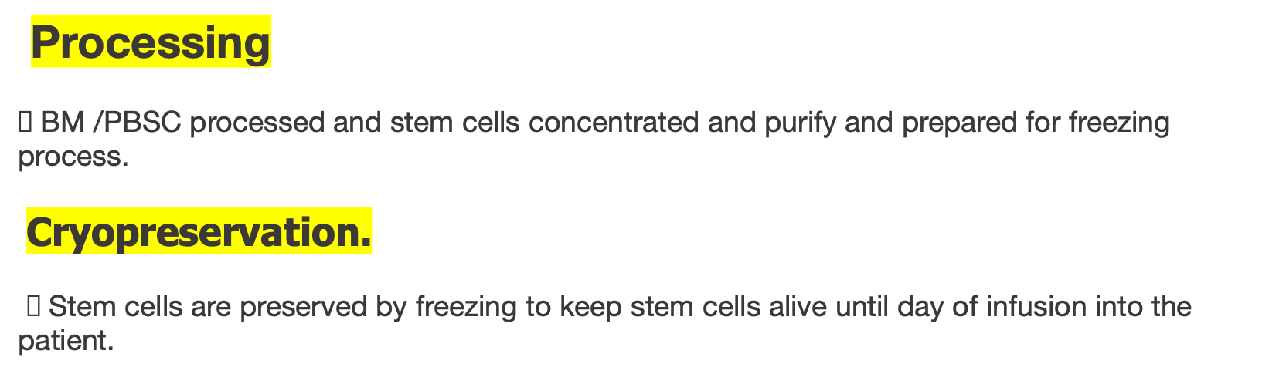
Transplant process:
2-Processing & Cryopreservation

Slide 9
Transplant process:
3-Conditioning (Chemotherapy Regimen)
q The conditioning period 7-10 days.
q By delivery of chemotherapy and/or radiation
q To eliminate malignancy.
q To suppress the patient’s immune system from rejecting the new stem cells
q To create space for the new cells.
Notes:
Bone marrow transplantation regimens vary from one patient to another, and depend upon the type of cancer

Slide 10
Transplant process:
4-Stem cells infusion
q Infusion - 20 minutes to an hour, varies depending on the volume infused.
q Infused through a central venous line CVL, much like a blood transfusion.
q Premedication with acetaminophen and diphenhydramine to prevent reaction.

Slide 11
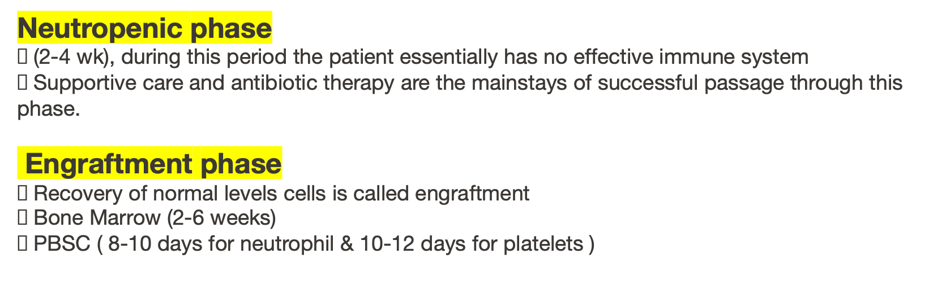
Transplant process: 5
Recovery
Notes:
(Commonly patients require transfusion of red cells and platelets).

Slide 12
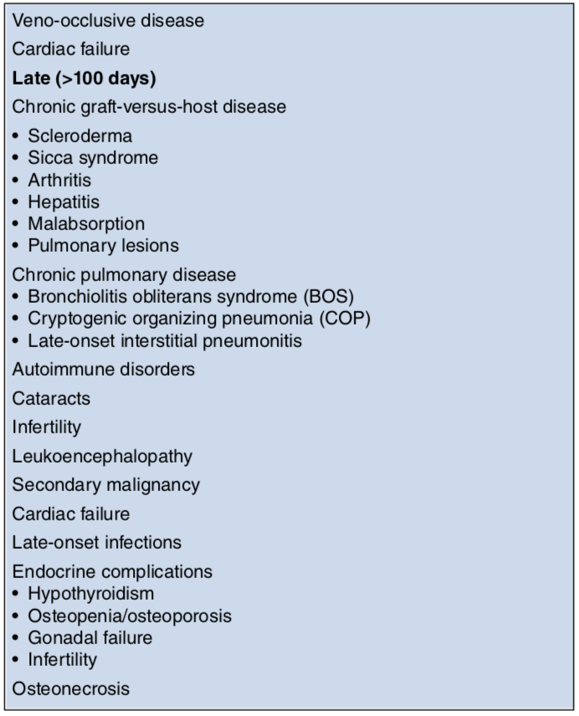
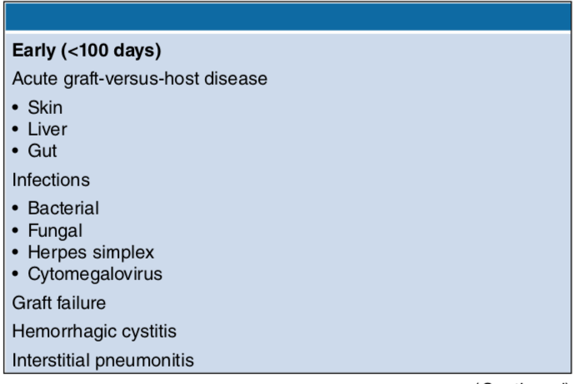
Notes:
ALLOGENEIC STEM CELL TRANSPLANTATION: COMPLICATIONS

Slide 13
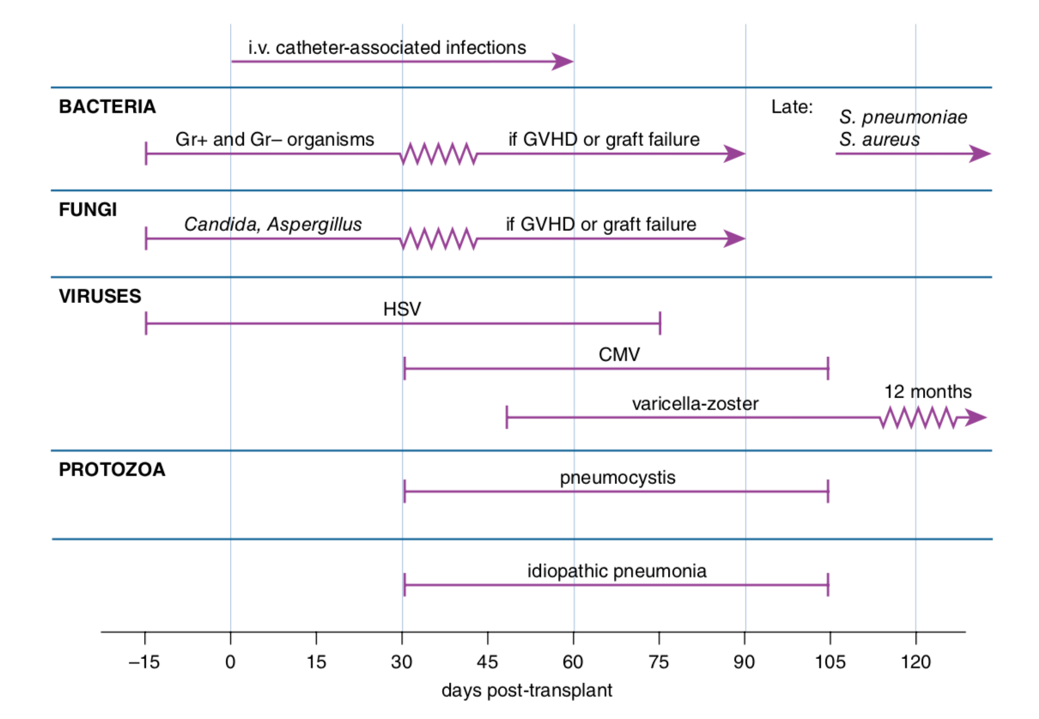
Notes:
Infections complicating allogeneic stem cell transplantation, according to the typical time sequence of onset.

